Slide 1

DOMAIN- HEALTHCARE
Top 3 Unmet Needs
Administrative overload for doctors
Doctors spend 30–40% of their time on paperwork instead of patient care
Fragmented healthcare systems
EHRs, hospitals, and insurance platforms do not communicate, requiring manual data transfer.
Physician burnout driven by non-clinical work
Burnout reduces quality of care and increases costs
Notes:
Talk track:
“Our domain is healthcare, and the biggest unmet needs are not always clinical—they’re operational.”
“First: administrative overload. Doctors spend roughly 30–40% of their time on paperwork instead of patient care.”
“Second: fragmented systems. EHRs, hospitals, and insurance platforms often don’t communicate, so staff do manual copy-paste and data transfer.”
“Third: this drives physician burnout. More non-clinical work reduces quality of care and increases costs.”
“So the unmet need is clear: reduce administrative work so clinicians can focus on patients.”
Transition line to next slide:
“Now let’s turn these unmet needs into a specific venture idea.”

Slide 2
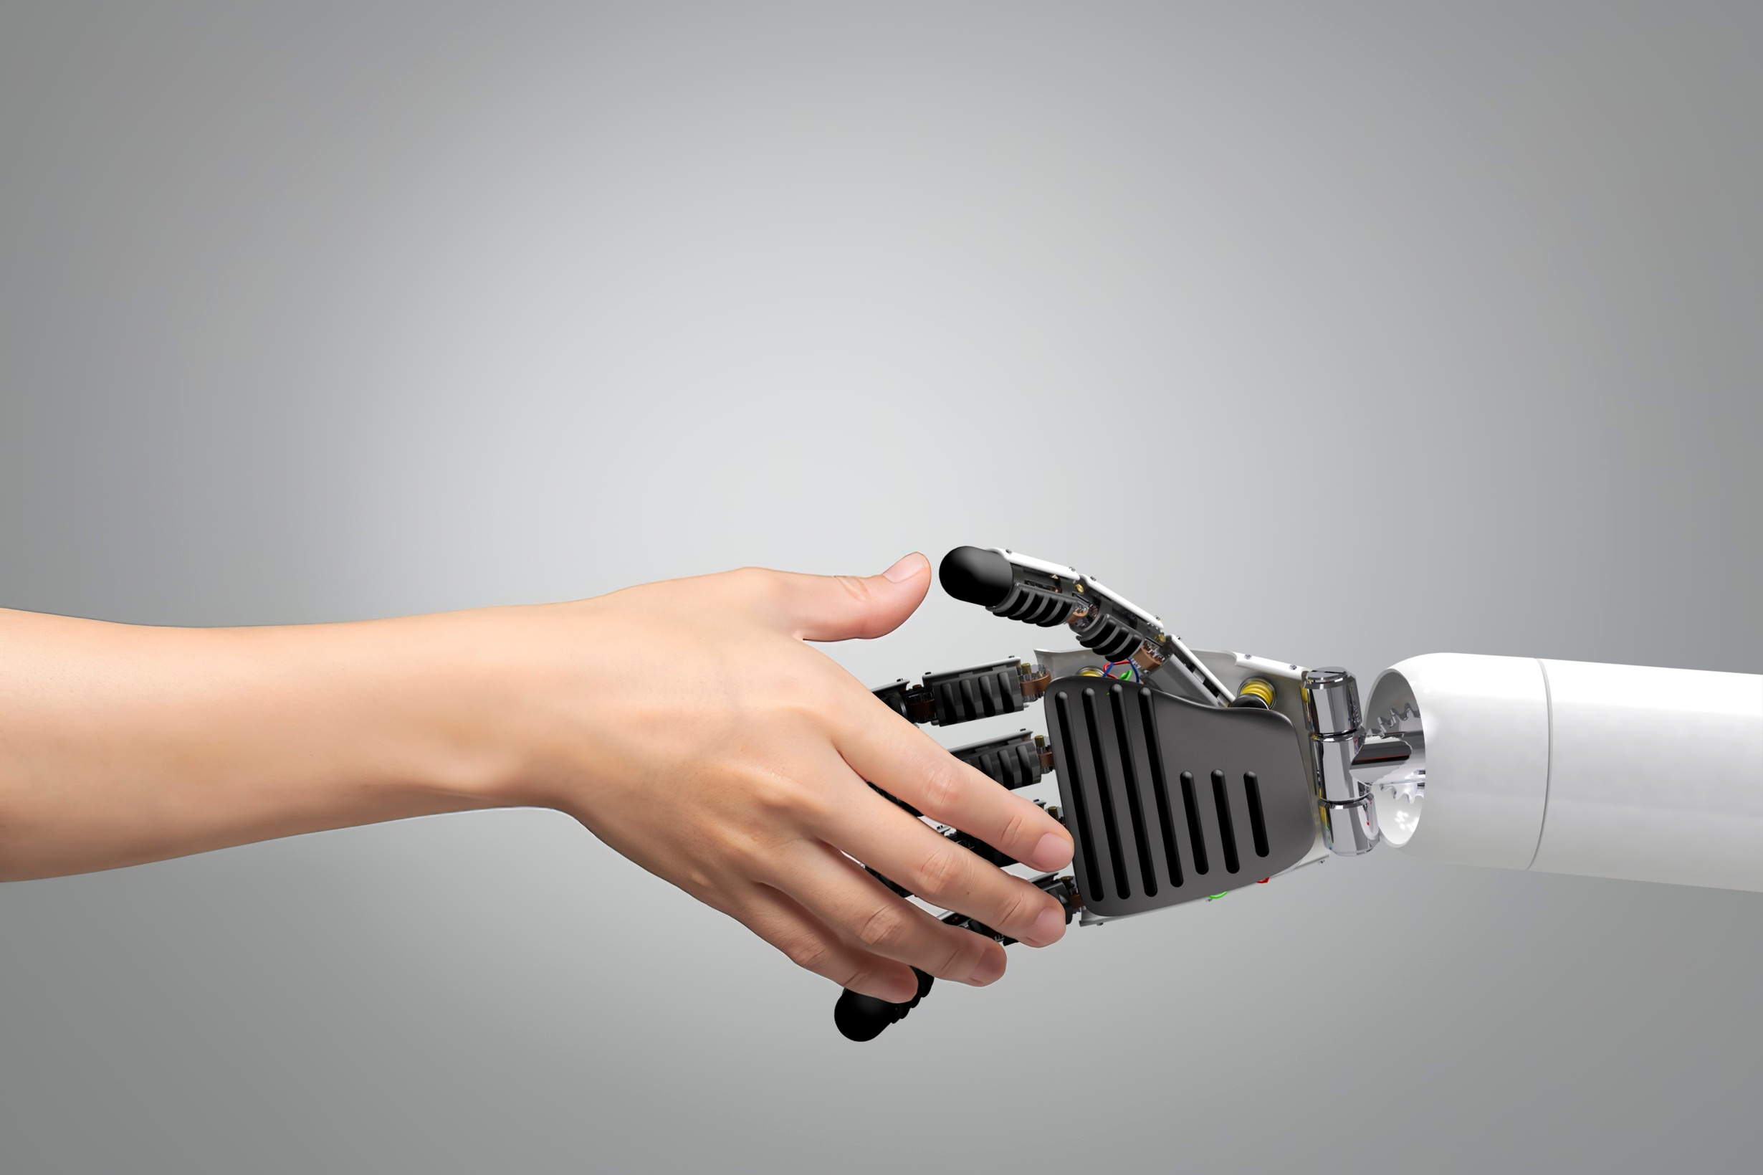

Venture Idea
AI Medical Administrative Assistant
OPPORTUNITY
$1T+ ANNUAL ADMINISTRATIVE WASTE IN HEALTHCARE
REDUCE ADMIN WORKLOAD BY 30–50%
LOWER BURNOUT, LOWER COSTS, BETTER PATIENT CARE
CUSTOMER
CLINICS, HOSPITALS, OUTPATIENT MEDICAL PRACTICES
WHY AI
MODERN LLMS UNDERSTAND MEDICAL CONTEXT
CAN GENERATE STRUCTURED DOCUMENTATION AND FILL FORMS
IDEAL FOR PROCESS AUTOMATION, NOT MEDICAL DECISION-MAKING
LOW REGULATORY RISK (NO DIAGNOSIS, NO CLINICAL JUDGMENT)
PROBLEM
DOCTORS AND STAFF WASTE SIGNIFICANT TIME ON DOCUMENTATION, FORMS, AND INSURANCE PAPERWORK
WHAT AI DOES / DOES NOT DO
✅ WRITES REPORTS, FILLS FORMS, TRANSFERS DATA
❌ DOES NOT DIAGNOSE OR MAKE CLINICAL DECISIONS
Notes:
Talk track:
“Our target customers are clinics, hospitals, and outpatient medical practices.”
“The problem is that doctors and staff waste significant time on documentation, forms, and insurance paperwork.”
“The opportunity is huge—there’s $1T+ in annual administrative waste in healthcare. If we reduce admin workload by 30–50%, we can lower burnout, reduce costs, and improve patient care.”
“Why AI? Modern LLMs can understand medical context and generate structured documentation and fill forms—this is process automation, not medical decision-making.”
“And importantly, what the AI does and does not do: it writes reports, fills forms, and transfers data—but it does not diagnose or make clinical decisions, keeping regulatory risk lower.”
Closing line (optional):
“In short: we’re building an administrative co-pilot that saves time, reduces burnout, and improves the business side of care—without practicing medicine.”

